Slide 1

Nivedha .s

Slide 2
FINGER PRINT MATCHING

Slide 3
ADENDA
PROBLEM STATEMENT
PROJECT OVERVIEW
WHO ARE THE END USERS ?
YOUR SOLUTION AND ITS VALUE PROPOSITION
THE WOW IN YOUR SOLUTION
MODELING
RESULTS

Slide 4
PROBLEM STATEMENT
Develop a fingerprint matching system capable of accurately identifying or verifying individuals based on their fingerprint patterns. The system should be able to efficiently compare a captured fingerprint with a database of stored fingerprints to determine if a match exists.

Slide 5
PROJECT OVERVIEW
This project aims to develop a fingerprint matching system for accurately identifying individuals based on their fingerprints. The system will involve capturing high-quality fingerprint images, extracting distinctive features, and comparing them with stored templates in a database. Key objectives include achieving high accuracy, efficiency, and robustness against variations in fingerprint quality. The system will be designed to integrate seamlessly with existing security systems, ensuring user-friendliness and compliance with relevant regulations.

Slide 6
WHO ARE THE END USERS ?
Security Personnel: Security personnel who need to verify the identity of individuals entering restricted areas.
Law Enforcement: Law enforcement agencies using fingerprint identification for criminal investigations and forensic analysis.
Government Agencies: Government agencies employing fingerprint matching for border control, immigration, and identity verification purposes.
Private Sector: Private organizations implementing fingerprint-based access control systems for securing their premises and sensitive information.
Individuals: Individuals using fingerprint authentication on personal devices such as smartphones and laptops for secure access.

Slide 7
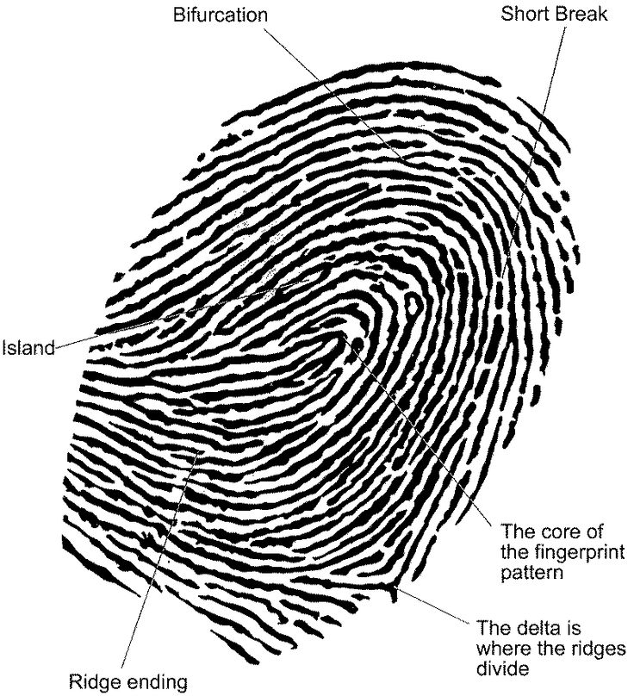
.

Slide 8
YOUR SOLUTION AND ITS VALUE PROPOSITION
Utilizing state-of-the-art algorithms, our solution accurately identifies individuals based on their fingerprints. It seamlessly integrates with existing systems and databases, ensuring easy adoption and compatibility. Our system provides fast and reliable matching, even with varying fingerprint qualities, enhancing security and efficiency.
Value Proposition:
Accuracy: Our solution ensures precise fingerprint matching, reducing false positives and enhancing security.
Efficiency: With fast matching algorithms, our system streamlines authentication processes, saving time and resources.
Compatibility: Seamless integration with existing systems minimizes disruption and facilitates smooth implementation.
Robustness: Our system handles variations in fingerprint quality effectively, maintaining reliability in diverse environments.
Security: By offering secure authentication, our solution safeguards sensitive data and premises from unauthorized access.

Slide 9
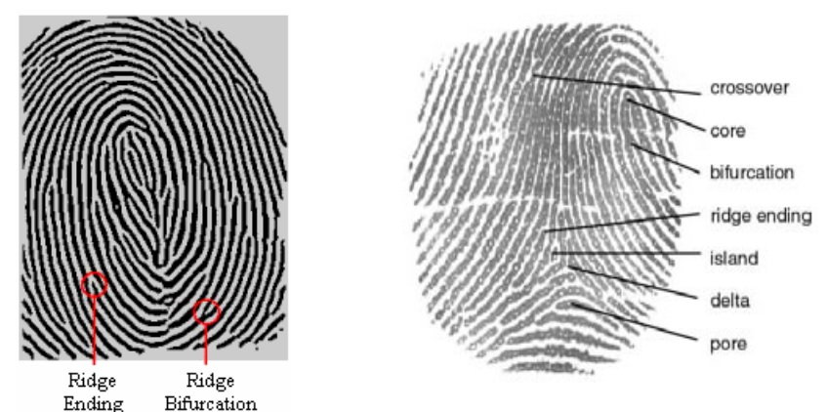
Fingerprint features and patterns

Slide 10
THE WOW IN YOUR SOLUTION
Our fingerprint matching solution stands out with its:
Unparalleled Accuracy and Speed:
Utilizing cutting-edge algorithms, our system achieves unmatched accuracy in fingerprint matching while delivering lightning-fast results. Say goodbye to false positives and lengthy authentication processes – with our solution, security meets efficiency like never before.

Slide 11
MODELING
Fingerprint matching modeling involves creating algorithms and systems to compare and identify fingerprints accurately
It utilizes various techniques like
Ridge pattern analysis,
Minutiae matching and
Neural networks
to analyze and match fingerprints for forensic or security purposes. These models aim to identify unique patterns and features within fingerprints to establish matches reliably.

Slide 12
RESULT
Fingerprint matching results indicate the degree of similarity or identity between two fingerprints. It typically yields a score or confidence level indicating how closely the features of the fingerprints match. Higher scores indicate a higher likelihood of a match, while lower scores suggest differences between the prints. These results are crucial for forensic investigations, biometric authentication systems, and security applications.

